Slide 1
Data607 Final Project
2019 Trump Tweets

Slide 2
Big Bang Team
Sie Song Wong
Anil Akyildirim
Joe Rovalino

Slide 3
Can we predict stock market fluctuations based on President Trump’s tweets?

Slide 4
Agenda
Organizational
Lifecycle
Team formation, Decision on topic of interest
Data Acquisition, Data cleanup, Topic model, sentiment creation
Analysis of sentiment of tweets vs market data
Conclusions
Wrap up

Slide 5
Organize
Slack Private Channel
Collaboration Tool
Asynchronous - group threads and breakout sessions
Skype
Voice and video
Github
Version Control

Slide 6
Lifecycle
Formed Team
Explored question(s) of interest/decision on topic --> Trump Tweets
Researched Topic model approaches
Tested Connectivity to Twitter API and package twitterR
Downloaded Tweet data and S&P market data
Performed data analysis and data cleanup

Slide 7
Lifecycle (cont.) -
Consulted with Professor on approach
Aggregated tweets by date to create sentiment/measure
Compared Tweet sentiment and S&P performance
Tweets tokenized/frequency of words
Cleanup corpus
Prepared Visualizations to assist with conclusion analysis

Slide 8
Lifecycle (cont.) -
Compared Tweet sentiment and S&P performance (cont.)
Tweets tokenized/frequency of words
Cleanup corpus
Create and filter Document Term Matrix (DTM)
DTM exploration
Prepared Visualizations to words

Slide 9
Lifecycle (cont.) -
Visualization of stock data trends
Applied LDA Topic Model
Identify the topics of interest
Create LDA model using parameters Gibbs method for 30 topics
Per Document classification
Sentiment Analysis
Sentiment score vs stock price change

Slide 10
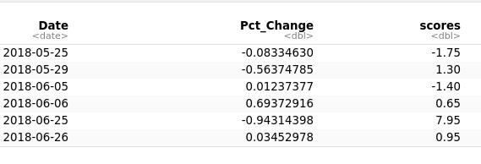
Conclusion
Surprise! Slight negative linear correlation b/n the sentiment scores and percent change on stock market.
Sentiment Scores fluctuates more than the Percentage Change in Stock Market.
Top 5 words - "china", "trade", "dollar", "billion" and "deal" - most common within the topic with most impact to stock market price change
Explicit "trade" word in the tweet, the most common word/phrase are: "such as deal", "billion" , "china", "countri", "dollar", "year", "unit", "talk", "good", "usa", "long" and "meet"

Slide 11
Wrap Up
Q and A
Thank You!

